Slide 1
KANO MODEL
Name:Salah Hasanin Said
ID:20161816

Slide 2
What is kano model ?
The Kano model is a theory of product requirements and customer needs .

Slide 3
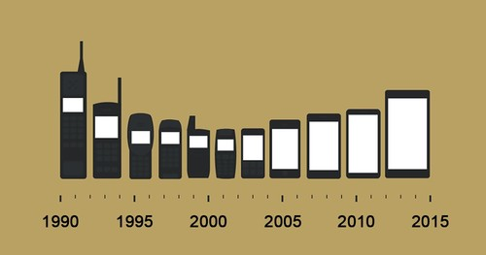
KANO MODEL
*Product development and Customer Satisfaction

Slide 4
KANO MODEL
The Kano model assumes that any site, regardless of its advantages or capabilities, can be categorized into three main types:
1-Basic Attributes
2-Performance Attributes
3-Delight Attributes

Slide 5




1- Basic Attributes
Represent the things that must exist on the site, if the user does not find these factors will not be satisfied with the site and if found, this is normal does not change the quality of the site
Satisfaction Very high!
Execution Poor (or not at all)
Execution Excellent
Satisfaction Very low !

Slide 6
2- Performance Attributes
These attributes result in satisfaction when fulfilled and dissatisfaction when not fulfilled.
Satisfaction Very high!
Execution Poor (or not at all)
Execution Excellent
هذه الصفات يؤدي إلى الارتياح عند الوفاء بها وعدم الرضا عندما لا تتحقق
Satisfaction Very low !

Slide 7
3-Delight Attributes
These attributes provide satisfaction when achieved fully, but do not cause dissatisfaction when not fulfilled
Satisfaction Very high!
Execution Poor (or not at all)
Execution Excellent
Satisfaction Very low !

Slide 8
KANO MODEL
*The effect of time on the Kano model:
Competition is increasing day by day and therefore the competitive advantages of your product launched this month will not be competitive after 6 months

Slide 9
THANK
YOU

